Slide 1

Dungeness Off-Channel Reservoir Project Update
Board of County Commissioners
June 30, 2025

Slide 2
Overview of Presentation
Dungeness Off-Channel Reservoir (OCR) Project Design Updates
Project Funding and Cost Estimate Updates
Stormwater Capture and Aquifer Recharge Infiltration Facility (SCARIF) Project Status
Other Project Updates
  Old Dump Site Clean-up
  Park and Recreation Planning Efforts

Slide 3
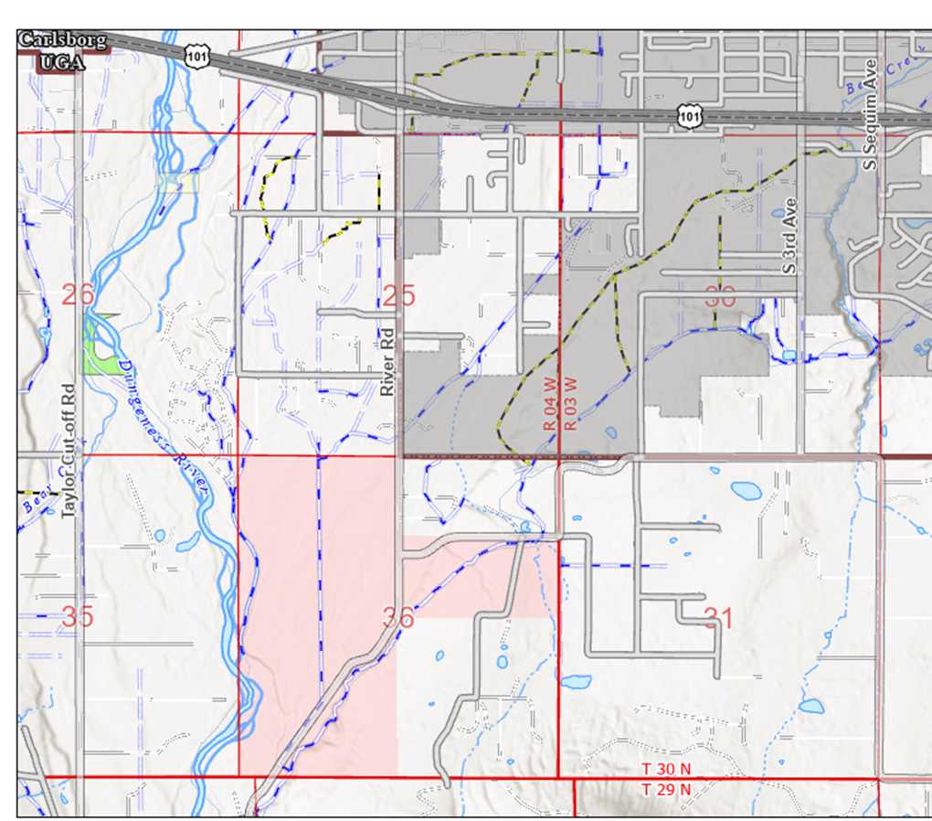
Vicinity Map
Sequim
Oct. 2024: County acquisition of ~ 400 acres from state Dept. of Natural Resources
  $1,240,100 purchase paid for under state Ecology Streamflow Restoration Grant
Sequim
Happy Valley Rd.
River Rd.

Slide 4
Targeted Benefits
Targeted Benefits
  Streamflow restoration for salmon
  Long-term agricultural viability and climate-resilient water supply
  Infiltration and aquifer recharge
  Stormwater Management/Flood Mitigation
  Public recreation opportunities

Slide 5
Why Again This Property?
Watershed location upgradient of much of the irrigation demand on east side of Dungeness River
Ability to fill and release water from reservoir by gravity
Proximity to existing irrigation infrastructure
Large enough size.
Availability of suitable on-site earthen materials for reservoir construction.

Slide 6
Dungeness Off-Channel Reservoir Design Update
Location and Configurations Considered
Design Status and Next-Steps for Option E1

Slide 7
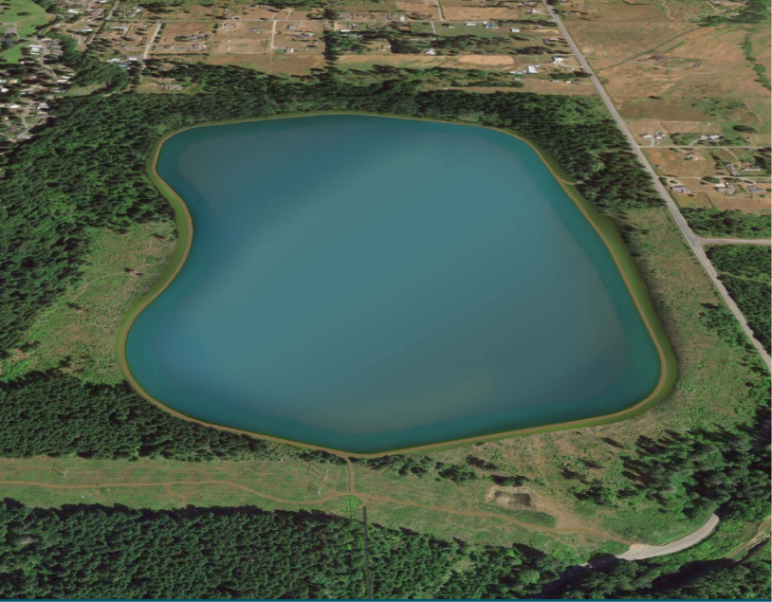
2016 Preliminary Concept
Source: Executive Summary and Project Proposal – Dungeness Off-Stream Reservoir Project , Anchor QEA, January 2016
River Rd.
~ 88 acres
Under direction of:
Washington Water Trust
City of Sequim
Dungeness Water Users Assoc.
Clallam Conservation District
Introduced to other stakeholders: Clallam County, Jamestown S’ Klallam Tribe, & state agencies.
BPA Easement

Slide 8
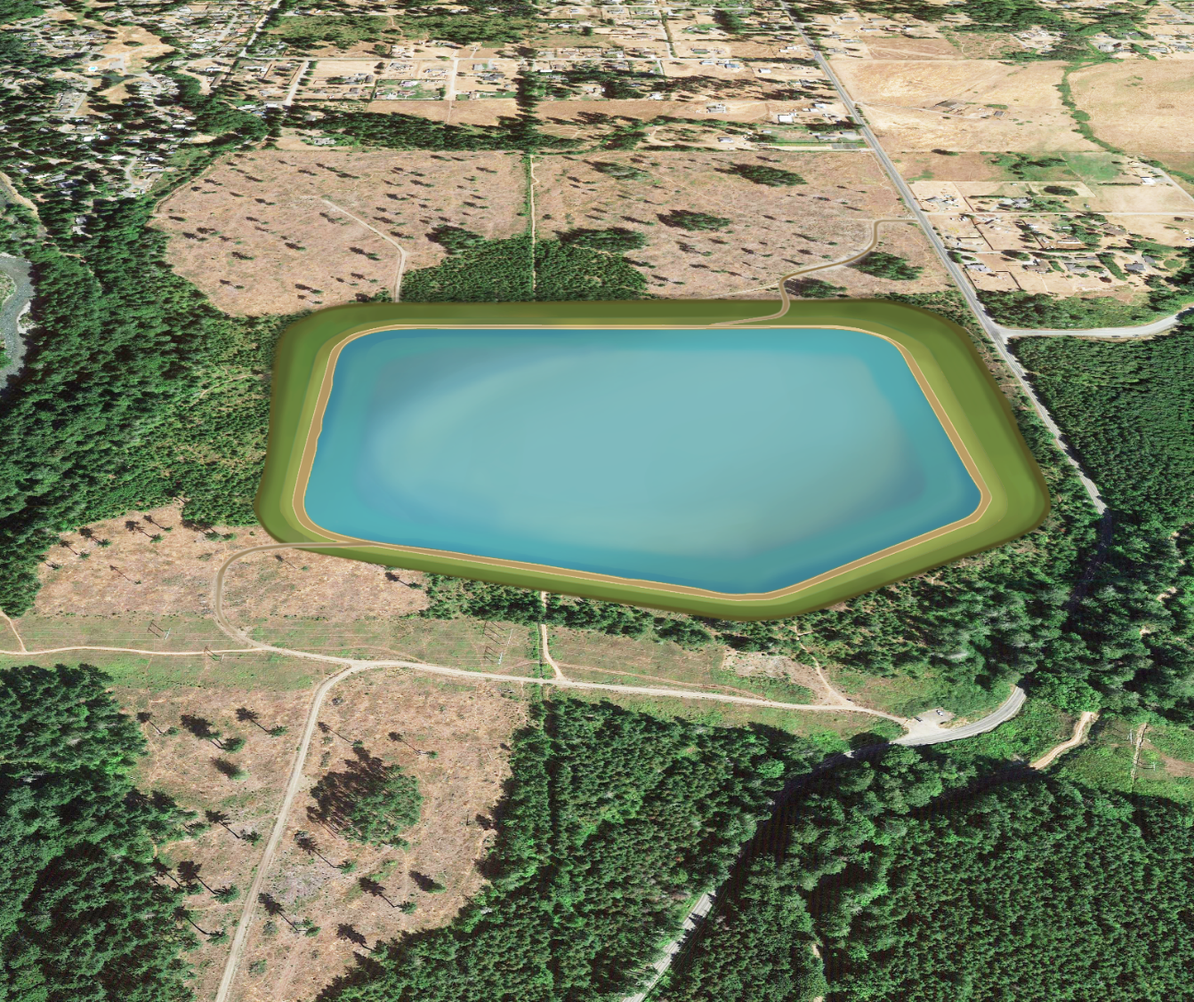
Off-Channel Reservoir (OCR)
2022 Preliminary Design
River Rd.
Presented at well-attended December 6, 2022, Open House
Main Areas of Public Concern Related to Design:
  Safety of downgradient residents and properties
  Height of embankment
  Volume of water stored above-ground.
~ 42 acres
BPA Easement

Slide 9
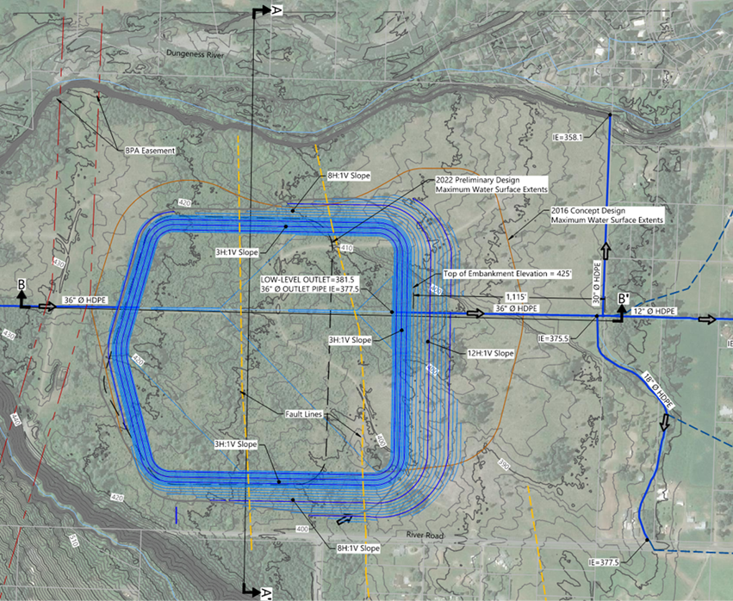
2023 Options A-C
Option C Shown
Reduced Embankment Heights:
  North Embankment: From ~ 30 feet to between 14 (Option C) and 22 feet (Option A)
  South Embankment: From ~ 15 feet to between 0 (Option C) to 5 feet (Option A)
Increased % volume of stored water below ground level from 37% to between 46% (Option A) to 62% (Option C)
Options A-C retain similar storage capacity to 2022 Preliminary Design of 1,591 Acre-feet
BPA Easement
River Rd.
Happy Valley Rd.

Slide 10
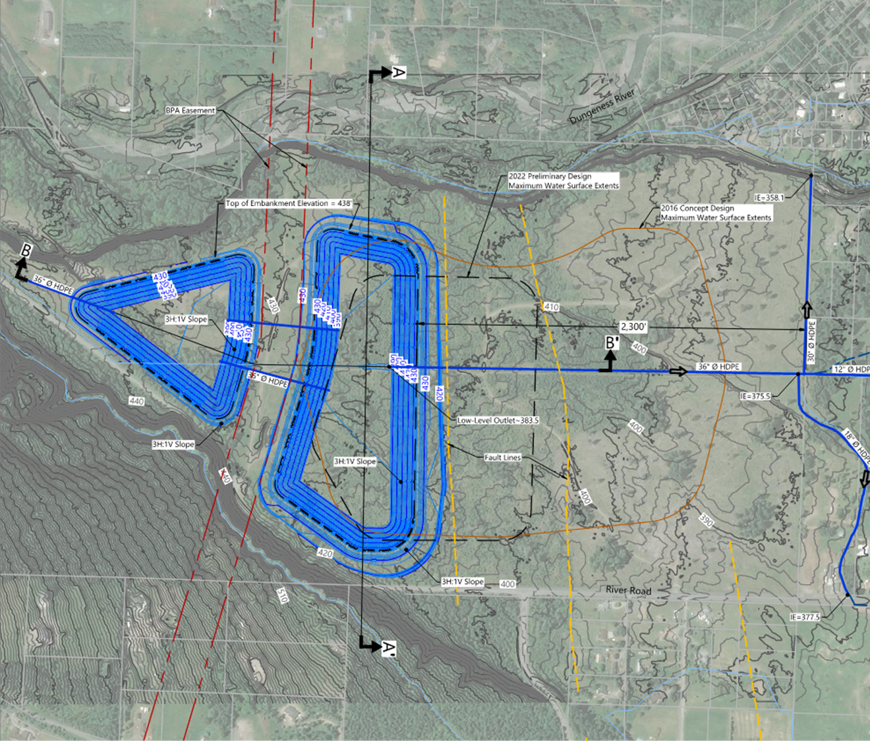
2023 Option D
Completed to address preliminary seismic reconnaissance results that recommended shifting OCR further south
Configured to locate reservoir storage outside of BPA easement
Like Options A-C Reduced Embankment Heights:
  North Embankment: From ~ 30 feet to ~ 23 feet (North Cell) and ~ 8 feet (South Cell)
  South Embankment: From ~ 15 feet to ~ 10 feet (North Cell) and to none (South Cell)
Increased % volume of stored water below ground level from 37% to 50% (North Cell) to 85% (South Cell)
Footprint 2,285 feet from north property line development areas.
BPA Easement
River Rd.
Happy Valley Rd.

Slide 11
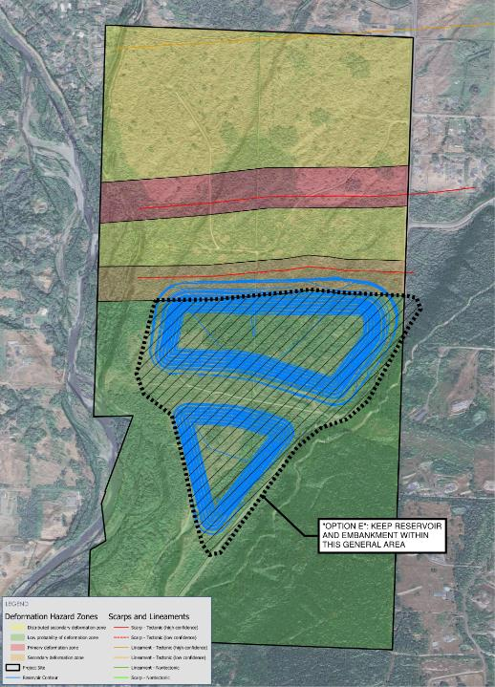
Recommended Area
Consultant Design Team Recommends Reservoir Location within Option E footprint based on:
  Additional Geotechnical Evaluation
  Additional Seismic Review & Fault Analysis
  Other Information
Option E Configurations Presented at the October 22, 2024, Community Information Meeting and Open House
BPA Easement
Option E Footprint
Keep Reservoir Within this General Area

Slide 12
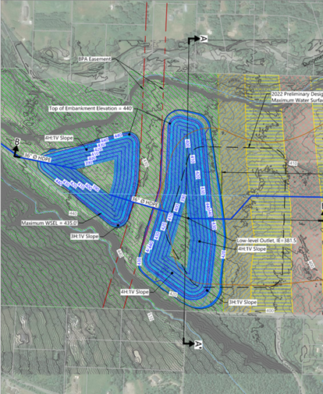
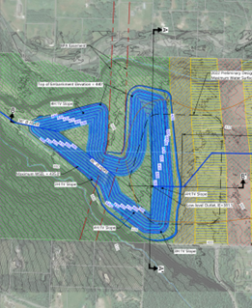
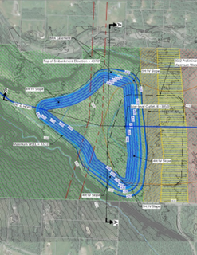
2024 OCR Option E Configurations
Option E1
Option E2/E3
Option E4
BPA Easement
BPA Easement
BPA Easement
River Rd.
River Rd.
River Rd.
Happy Valley Rd.
Happy Valley Rd.
Happy Valley Rd.
Storage Capacity Below Existing Ground Elevation: 67% to 85%

Slide 13
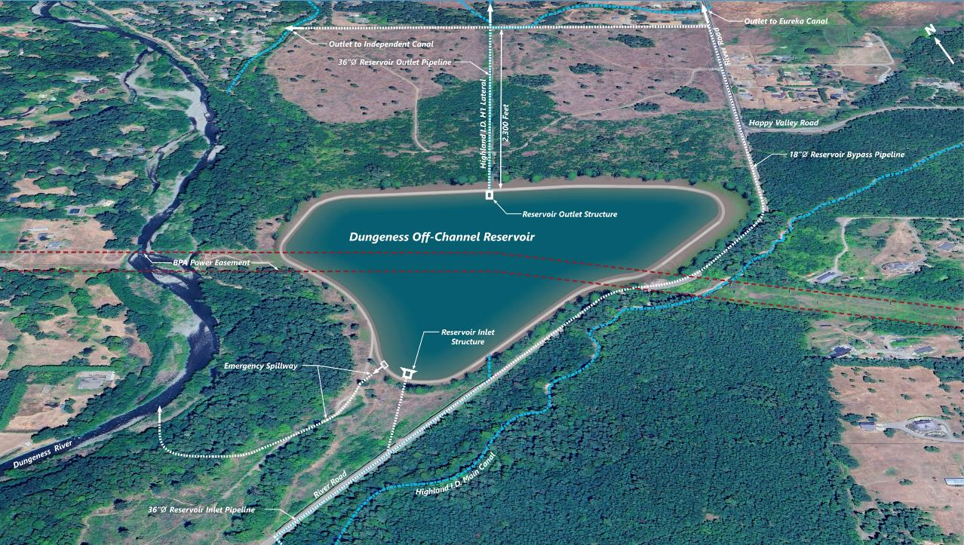
BPA Easement
~ 47 acres
Option E4
~ 1,610 Acre-Feet Storage Capacity

Slide 14
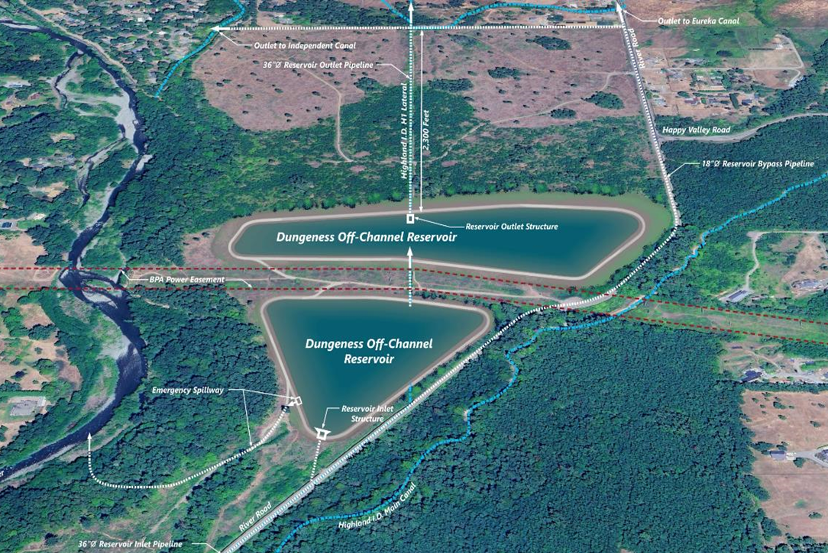
2025 Recommendation—Option E1
Why E1?:
Footprint is outside of BPA Easement
Compared to Option E4:
  Saves an estimated 3 to 4 years time and $2 to 3 million in costs on design, env. review & permitting
  Saves an estimated $15 million or more on construction (Option 4 includes relocation of BPA infrastructure)
Two cells could allow for phased construction.
Does not preclude future expansion to join cells.
Potential through further design refinements to increase storage capacity to ~ 1,300 Acre-Feet.
Option E1
~ 960 to 1,307 Acre-Feet Storage Capacity

Slide 15
Next Steps – Reset Design Based on Option E1
The Consultant Design Team will need to:
  Further evaluate Option E1 embankment and reservoir design options, including use of fabricated liner for seepage control and adjustments to maximize storage capacity
  Complete a cost analysis based on the above evaluation with the objective to narrow down the embankment design and allow for selection of a preferred Option E1 configuration
  Reset the preliminary drawings (30% design) to reflect the preferred Option E1 design configuration after a preferred configuration is selected
Geotechnical engineer will plan for completion of priority explorations needed to support additional design work

Slide 16
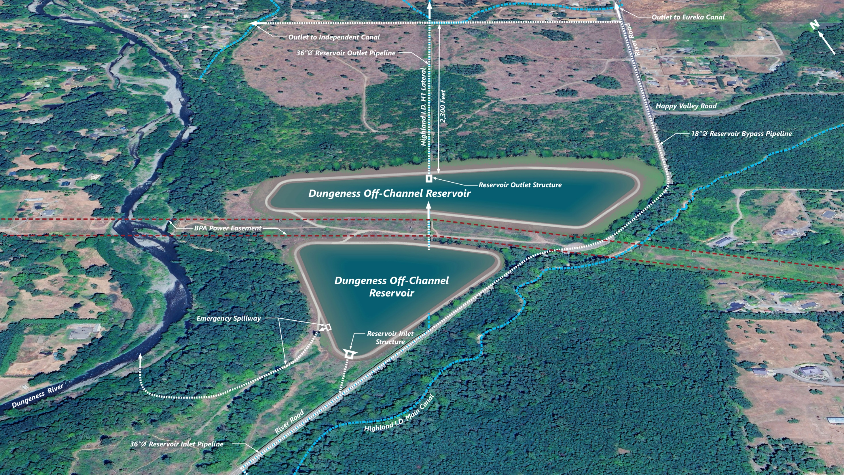
Keep Structural Portion of Embankments In Low Probability of Seismic Deformation Area
Maintain Clearance Between Reservoir and Top of Bluff
Maintain Clearances Around BPA Infrastructure, as Specified by BPA
Maintain Clearance Between Reservoir and Edge of River Road
Key Design Constraints – Reservoir Option E-1

Slide 17
Adjust Embankment to More Closely Match Boundary of Low Probability of Seismic Deformation Area
Adjust Embankment Slopes, As Recommended by Geotechnical Engineers Through Additional Analysis
Adjust Embankment while Maintaining Clearances Specified by BPA
Adjust Top and Bottom Elevations of Reservoir
Fine Tune Amount of Freeboard Allowed
Shift Edges of Reservoir Embankments Slightly Closer to River Road
Potential Adjustments – Reservoir Option E-1

Slide 18
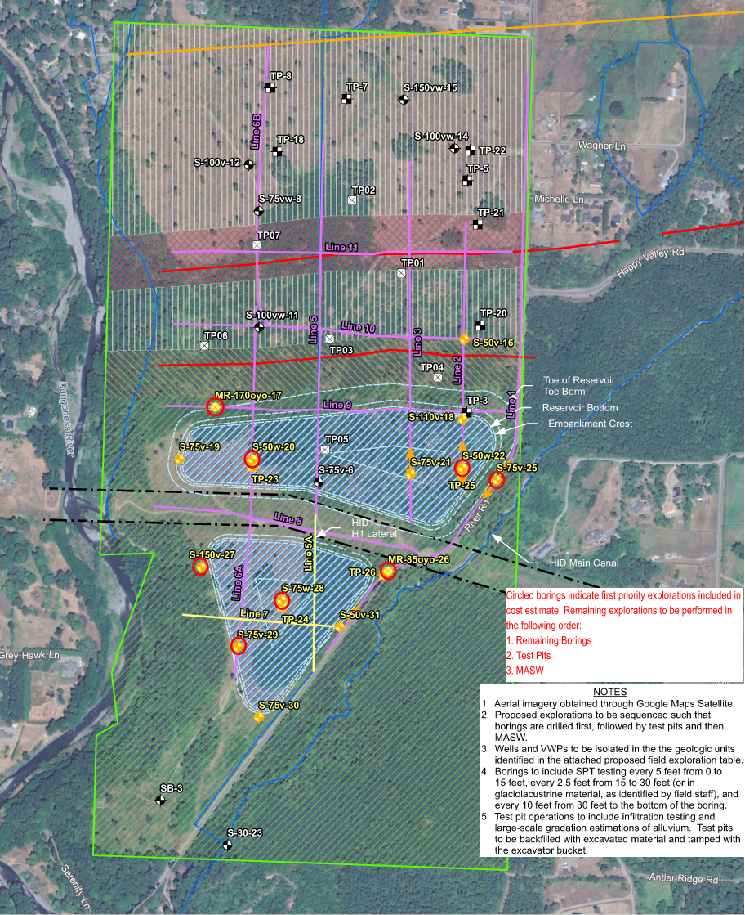
Geotechnical Exploration Plan – Next Steps
Schedule and Complete Priority Borings (Those Outlined in Red)
Additional Reconnaissance of Bluff Adjacent to Dungeness River
Reconnaissance of Landslide Hazards on Hillside to East
Review of Liner Options

Slide 19
Design Schedule
 | Targeted Quarter to Complete Work | Comment
Revised Preliminary Design | Q4 2025 to Q1 2026 | Remaining Ecology funding adequate to complete Preliminary Design for Option E1.
Priority Geotechnical Site Investigations & Related Evaluation Work | Q4 2025 | Remaining funding sufficient to cover all or most priority geotechnical work. May require Ecology approval to reallocate available funds from other grant tasks (e.g., site cleanup) and/or Phase I FEMA HMPG Award to fully complete this work
Remaining Detailed Design and Permitting | Q4 2026 to Q1 2027 | Requires Securing Additional Funding

Slide 20
Funding and Cost Estimate Updates
Dungeness Off-Channel Reservoir (OCR) and Appurtenances
Dungeness OCR Upstream Irrigation System Infrastructure Improvements
Dungeness OCR Downgradient Irrigation System Infrastructure Improvements

Slide 21
Dungeness OCR State Ecology Grant Status (June 2025)
Task | Grant Budget | Remaining (June 2025) | Status
Project Management | $385,877 | $29,224 | Ongoing
Property Appraisal Related | $75,000 | $9,842 | Completed
Design | $2,900,300 | $619,227 | In Progress
Permitting & Related Work | $156,727 | $73,790 | On Hold
Outreach, Coordination, & Water Rights | $334,950 | $24,608 | Ongoing
Land Acquisition, Dump Site Cleanup, & Related Work | $1,765,000 | $391,032 | Acquisition completed ($1,240,100) Dump Site Clean-up (awarded – Start in July)
Water Quality Monitoring | $70,000 | $57,370 | In Progress – Sampling of current irrigation system water quality for base line.
Supplemental Cultural Resources Review | $5,000 | $5,000 | If Needed
TOTALS | $5,692,854 | $1,210,093

Slide 22
Option E1—Reset OCR Design & Permitting Work
 | Estimated Remaining Design Costs | Estimated Remaining Grant Funding for Design | Estimated Funding Gap for Design*
Option E1 Preliminary Design & Related Priority Geotechnical Work | $738,000 | ~ $619,000 | $119,000
Detailed Design & Permitting Related Work | $1,103,000 to $1,453,000 | ~$74,000 (For Permitting Task) | $1,103,000 to $1,453,000
TOTALS | $1,841,000 to $2,191,000 | ~ $693,000 | $1,148,000 to $1,498,000
*Potential Funding Sources:
  $150,000 FEMA Hazard Mitigation Grant Proposal. (Pending Phase 1 Request)
  Reallocate available funds from other grant tasks. Estimate between $100 to 180K may be available mostly from cleanup of dump site grant task. (Requires Ecology approval)
  Request reallocation of state construction funding award to support design phase. (Requires Ecology approval)
  Other Funding (e.g., new grants)

Slide 23
Contract Amendments Needed
Request Grant Contract Amendment from Ecology to:
  Reallocate savings from other grant tasks to support design work and further outreach and water rights efforts.
  Shift part of construction grant awards to support completion of design and related support work (including outreach, water rights)
  Request an additional one-year time extension (to March 31, 2027)
  If above not approved, work with Ecology on scope of work to complete (e.g., Option E1 Preliminary Design) based on remaining budget and grant timeline.
Amend contract with Anchor QEA to reset scope of work and also, a time extension.

Slide 24
Off-Channel Reservoir & Appurtenances Construction Latest Cost Estimate
 | Current Cost Estimate* | Pending Grant Funding (Not Yet Secured) ** | Pending Funding Source**
Option E1 | $36,600,000* | $33,942,387** | $2,275,699: 2020 State Ecology Streamflow Restoration Grant (Awarded – Need to Complete Design Prior to Secure Funds) $1,680,000: 2022 State Ecology Streamflow Restoration Grant (Awarded – Need to Complete Design Prior to Secure Funds) $29,986,688: Federal Emergency Management Agency (FEMA) Hazard Mitigation Grant Program (HMGP) (Under Review)
*Construction cost estimates to be refined as design moves forward.
**The two state grants totaling ~ $3.9 million have been awarded but are not under contract. The County’s ~ $30 million FEMA HMGP grant application is pending review for funding.

Slide 25
Dungeness Off-Channel Reservoir (OCR)
Current Construction Funding Gap
County must complete design to be eligible for the ~ $3.9 million in awarded state grant funding for OCR Construction
The County’s ~ $30 million FEMA HMPG grant application remains under review and MAY NOT be funded.
  If selected for funding, award consideration would be phased:
    Phase 1 (Pre-Construction Work/Costs) [Requested: $150,000]
    Phase 2 (Construction)
Current Estimated Funding Gap
  If Pending State and Federal Grants Secured = ~ $4 Million (assumes Ecology approves shift of ~ $1.4 million from construction award to complete design).
  If FEMA HMGP Not Awarded = ~ $34.1 Million
Additional funding will need to be identified and obtained.

Slide 26
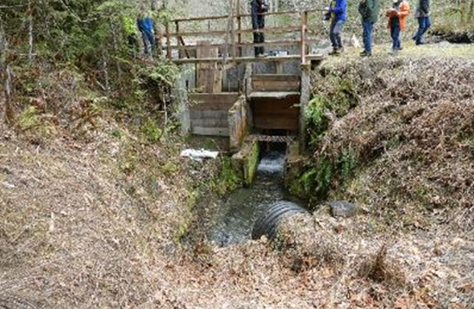
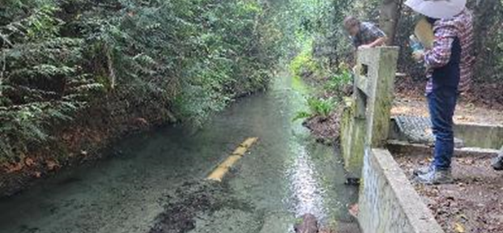
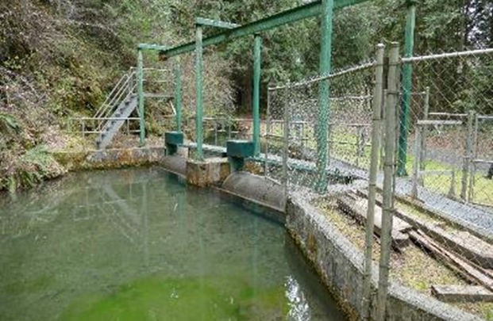
Dungeness OCR-Upgradient Irrigation System Infrastructure Improvements
Improvements to Highland Irrigation District (HID) headgate structure
Improvements to HID fish screens by WA. Department of Fish and Wildlife - Completed
Installation of a settling basin
Installation of ~6,000 feet of 36-inch pipeline in the upstream end of the Highland Irrigation District main canal
Flow control structure improvements & automation
Piping of HID lateral canal to reservoir location.

Slide 27
Dungeness Off-Channel Reservoir (OCR)
Upgradient Infrastructure Improvements
Preliminary 30% Design Completed
  Funded by State Grant (2019 Ecology Streamflow Grant)
Construction Estimate and Funding
Funding | Description | Grant Amount | Grant Match | Current Construction Estimate | Comments
Federal Congressional Directed Spending Appropriation | Piping of ~ 6,000 feet of Highland Irrigation Ditch (HID) Main Canal | $2,727,870 | None | $2,018,500 | Administered by USDA–Natural Resources Conservation Service (NRCS) Construction targeted to occur Fall 2025 or 2026 After Irrigation Season
US Bureau of Reclamation (USBOR) WaterSMART Grant | Upgrade HID diversion, flow control upgrades, settling pond, & pipe HID lateral to Reservoir. | $1,813,275 (Under Contract) | $604,425 | $1,758,900 | Match planned to be covered by awarded state grant. Design under review by state Fish and Wildlife and Jamestown S’ Klallam Tribe for fish improvements
 | TOTALS | $4,541,145 | $604,425 | $3,777,400 | Adequate funding based on current estimates.

Slide 28
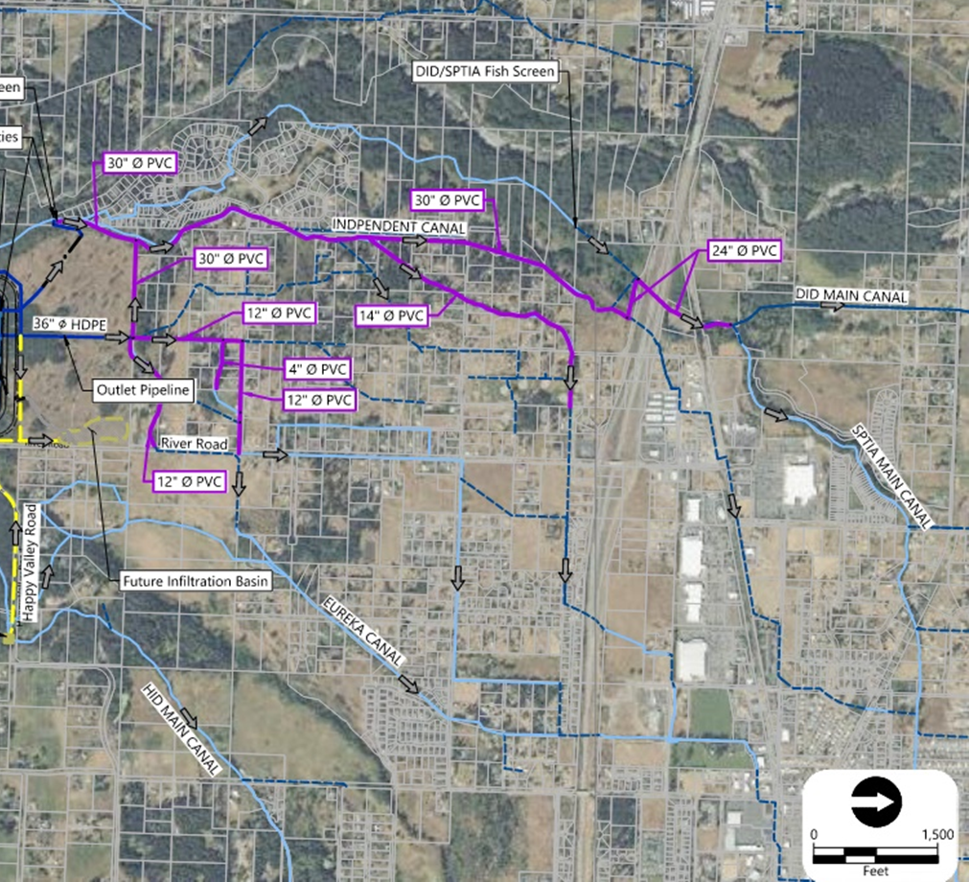
Downgradient Improvements
Improvements to irrigation delivery system needed to fully deliver water stored in the Off-Channel Reservoir to irrigated downgradient properties.
2021: Completion of 30% Preliminary Design (grant funded) by Clallam Conservation District
Task | Current Cost Estimate | Funding
Detailed Design & Permitting | ~$514,000 | No funding identified or applied for yet.
Construction | ~ $5.3 million | No funding identified or applied for yet.

Slide 29
Stormwater Capture and Aquifer Recharge Infiltration Facility (SCARIF) Project
Added Project Component to Proposed Clallam County FEMA Hazard Mitigation Grant Program (HMGP) Project Scope of Work.
Project was Previously under a City of Sequim Phase 1-FEMA HMGP Award

Slide 30
Stormwater Capture and Aquifer Recharge
Infiltration Facility (SCARIF) Project
Project Summary:
  Capture stormwater entering the ~ 2.5-mile segment of the Highland Irrigation District (HID) Main Canal above Happy Valley Rd.
  AND
  Pipe it for ~ ½-mile west to an infiltration facility constructed on the north part of the County property downgradient from the planned Dungeness Off-Channel Reservoir (OCR) site.
Relationship to Dungeness OCR Project: Connect the OCR with the SCARIF to allow for managed releases of OCR stored water to further augment aquifer recharge benefits form multiple sources.
Estimated Size: 10 – 15 acres to be confirmed during site evaluation and design phase.

Slide 31

Potential Infiltration Area
Est. 10 – 15 acres needed Northern Parts of Site to be Evaluated
Highland Main Canal
Dungeness Off-Channel Reservoir (OCR) & Stormwater Capture and Aquifer Recharge Infiltration Facility (SCARIF) Projects

Slide 32
SCARIF Project Funding and Status
Project is Contingent on Securing Grant Funding
Funding Now Under Review as Part of County ‘s FEMA Hazard Mitigation Grant Program (HMGP) Application
  Sequim had a previous Phase I (Site Evaluation, Design, Permitting) FEMA HMGP Award
  Sequim did not make substantial progress due to waiting for County acquisition of the River Rd. Property.
  Sequim closed out their grant and supported County taking lead on project
  County submitted an update to their FEMA HMGP application scope of work (SOW) for the Dungeness OCR to include the SCARIF
  County also submitted a budget to complete work:
    Phase 1 (Pre-construction/Design Work) = $300,000 to $340,000
    Phase 2 (Construction) = $1,400,000 to $1,800,000 (Preliminary Estimate to be Updated during Phase 1, if awarded)
Washington State Emergency Management Division and FEMA Reviewing Updated SOW and Budget

Slide 33
Other Related Project Updates
Old Dump Site Clean-up
Park and Recreation Planning Efforts

Slide 34
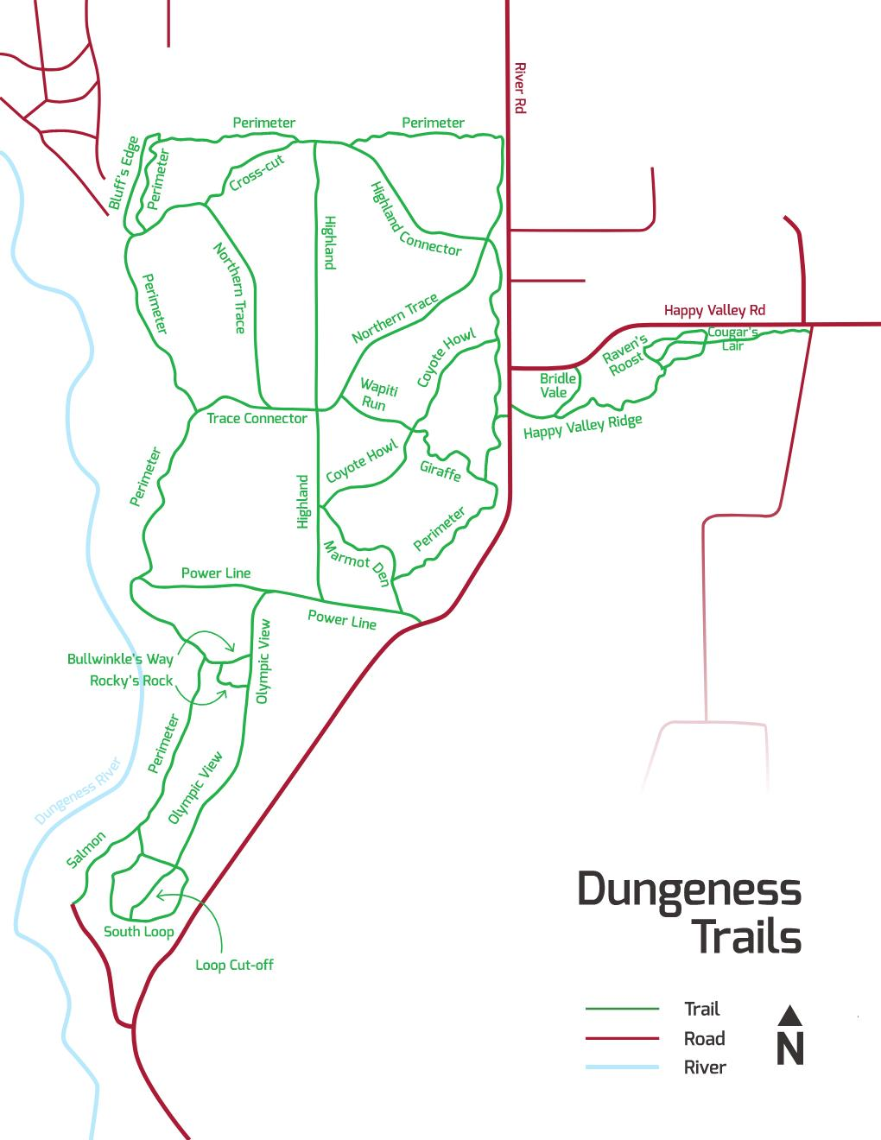
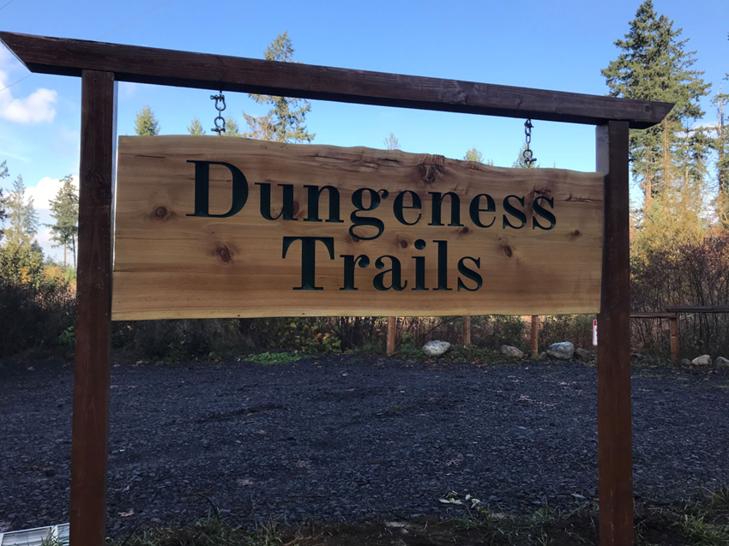
Park & Recreation Next-Steps
The entire ~ 400-acre site continues to be open to public and is popular for hiking, biking, and equestrian trail uses
County Parks Department is working on amendment of County Park Regulations to include the ~ 400-acre property as a new County Park (named Dungeness Trails).
County Parks Department Preliminary 2026 Capitol Improvement Request includes funding for an off-road gravel parking area and signage.
East Highland

Slide 35
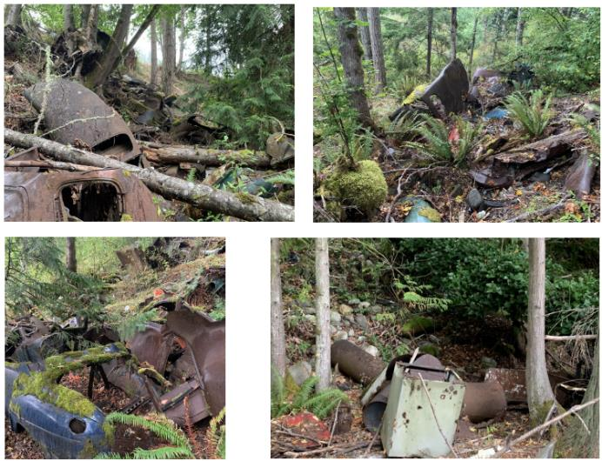
Project Status: Site Cleanup
Jan. 2024: Work Plan & Cost Estimates Completed.
Oct. 2024: Contract with Anchor QEA
  Topographic survey
  Quantify debris, soils & vegetation removal
  Soil sampling/environmental testing
  Design & permitting
  Bidding & construction phase assistance
  Construction Management
  Final debris removal documentation report per state requirements.
  Estimated Over 95% grant funded
Cleanup Contract Awarded: Work begins in July and expected to be completed by July/August
3-Year Post Removal Groundwater Monitoring and Site Closure

Slide 36
Known Costs as of June 2025
Anchor QEA Contract Amendment F: $159,809
  Spent to date: $116,058.66
  Remaining budget: $45,692.59
2 Grade LLC Contract: $153,207.45
Estimated staff charges: $7,500.00

Slide 37
Remaining Ecology Cleanup Funds: $391,032
Expenditure Category | $ Amount
Remaining Anchor QEA Costs | $45,693
2 Grade, LLC Contract | $153,207
Approximate Staff Charges | $7,500
TOTAL ESTIMATED COSTS REMAINING TO COMPLETE CLEANUP | $206,400 (Estimated $184,632 of Ecology Grant Funding Remaining after Clean-up)

Slide 38
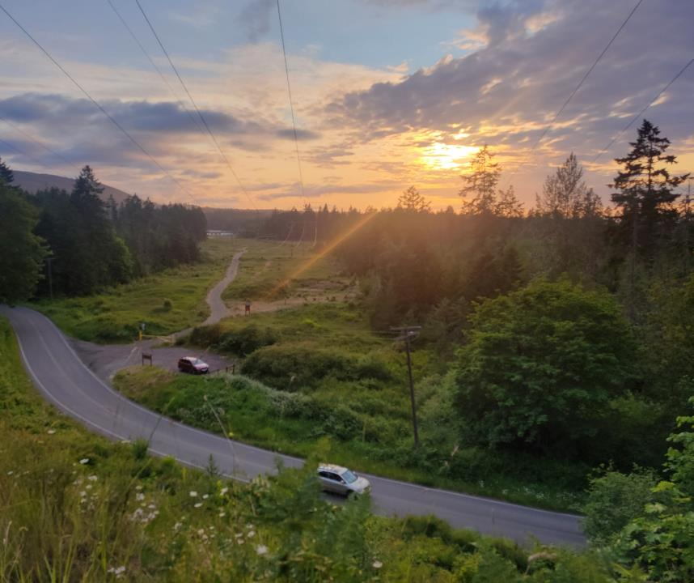
Questions???
Dungeness Off-Channel Reservoir Project

